Slide 1

ICT406 IT Professional Environment: Law, Ethics and Privacy Future Technologies
Dr. Abbass Ghanbary
a.ghanbary@aapoly.edu.au

Slide 2


Slide 3
Lecture Outline
Future technologies
Kardashev Scale
Ethical and legal factors

Slide 4
Future Technologies Believed by 2050
Artificial Intelligence: Ability of a machine to think.
Extended Reality: Experiencing the world around us.
Human and Machine Interface: Changing the way we interact with machines. Would they become part of us?
Gene Technology: Managing and manipulation of human cells potential collaboration with biotechnology (human and computer interaction).
3D Printing: Building 3D house.
Quantum Computing: Taking advantage of quantum mechanics to solve complex problems like cryptology, financial modelling,..
Nanotechnologies: Manipulating matter at the molecular level leading to computes allowing a fully functional system even part is broken.
Driverless Flying Vehicles
Notes:
Many new database developers suffer from the ‘spreadsheet syndrome’, creating as few tables as possible, often just a single table. They place dozens of columns in their table, to try and cover every possible piece of data, even though they often leave most columns unfilled for a given row.
By contrast database normalization aims to store the smallest amount of info possible in each table, leaving no columns that are filled for just a few of the rows. In fact, in a properly normalized table there should be very few empty(NULL) fields.
This is accomplished by restructuring the data into multiple tables, with each table containing a subset of the information.
Database normalization is the process of modifying your schema so that its tables conform to a progressive series of normal forms.

Slide 5
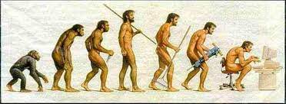

Slide 6
1% of Separation
By Neil de Grasse Tyson
Only 1% Separation between our DNA to Chimps.
Their best achievement is building blacks to reach banana
We have managed to walk on the moon and …………
What If there are other species only 1% more advanced than us?
https://www.youtube.com/watch?v=F200wpEpJ4w

Slide 7
Who was Nicolay Kardashev
Nikolay Semenovich Kardashev, one of the leading Russian astrophysicists, head of the Astro Space Center of the Lebedev Physical Institute, and a full member of the Russian Academy of Sciences.
The Kardashev Scale ranked civilizations based on the energy they consumed.
Type I: civilisations capable of using energy resources of a single planet.
Type II: civilisations that use the full energy of a star.
Type III civilisations that have access to the energy of a galaxy.
The following scientist have recommended Civilisation Type 7 now.
NASA/ADS. https://articles.adsabs.harvard.edu/pdf/2019A%26AT...31..399B
Notes:
Many new database developers suffer from the ‘spreadsheet syndrome’, creating as few tables as possible, often just a single table. They place dozens of columns in their table, to try and cover every possible piece of data, even though they often leave most columns unfilled for a given row.
By contrast database normalization aims to store the smallest amount of info possible in each table, leaving no columns that are filled for just a few of the rows. In fact, in a properly normalized table there should be very few empty(NULL) fields.
This is accomplished by restructuring the data into multiple tables, with each table containing a subset of the information.
Database normalization is the process of modifying your schema so that its tables conform to a progressive series of normal forms.

Slide 8
Type 0 Civilisation
Amazingly shocking. According to Kardashev scale. We are not even Type 1 civilisation. We are type 0.72 civilisation.
Has not fully reached technological advances.
This type requires energy from natural resources to develop.
Consumes enormous amount of energy by burning chemical fuel.
Notes:
And hey, odds are you can change more than one column, and you may have more than a million rows.

Slide 9
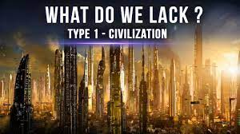
Notes:
And hey, odds are you can change more than one column, and you may have more than a million rows.

Slide 10
Type 1 Civilisation
Type 1 Civilisation (A Planetary Civilisation)
Produces energy at least 10¹⁶ power watts of energy per second.
The main source of power is nuclear fusion energy with no risk of nuclear accidents.
At this point, man can travel to any solar system.
Elimination of incurable diseases and regenerate any organ increasing human life span.
Live in any environment like sea, cloud,..
Control volcanos, weather and even earthquakes.
It will take 100 to 200 years for us to reach from civilisation 0.72 to an early type civilisation 1.0 producing 10 times more energy.
It would take around 3000 years to reach advanced civilisation type 1.
Notes:
And hey, odds are you can change more than one column, and you may have more than a million rows.

Slide 11
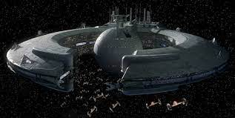

Slide 12
Type 2 Civilisation
Type 2 Civilisation (A Stellar Civilisation)
Harness the energy from neighbouring stars because nuclear fusion is not sufficient enough for advances in technology and science.
Gather and sort the required energy demands for growing population. We need to boost our energy production by 100,000 times.
Elimination of poverty.
Freely travel across planets in milky way galaxy.
Colonising space.
Regenerating any part of human body
It will take 100000 to 1000000 years for us to reach from civilisation 1 to civilisation 2.0.

Slide 13
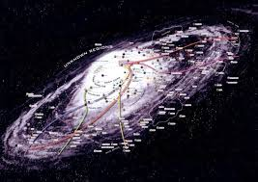

Slide 14
Type 3 Civilisation
Type 3 Civilisation (A galactic Civilisation)
Obtain energy similar to type 2 but from different galaxies.
Use of anti gravity devices for vehicles on astronomical scale.
Could use wormholes to travel through galaxies but not creating wormholes yet.
Maximum possible life span for any species. Science is at its end point.
The next step would be extracting consciousness from flesh and achieving immortality but not possible for type 3 civilisation.

Slide 15

Is this person going to office?
Is he going to work?

Slide 16
Type 4 Civilisation
Type 4 Civilisation (A Universal Civilisation)
The main source of energy would be supernovas (Extracting energy from explosions caused by final stage of star’s life.
Finaly can extract consciousness from flesh achieving immortality.
Can create life.
Are they God? Are we created by them?
Would the concept of multiple universes true? If yes, then we are talking about Multiverse.

Slide 17
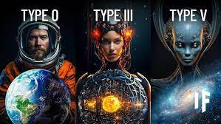

Slide 18
Type 5 Civilisation
Type 5 Civilisation (A Multiversal Civilisation)
Looking to white holes (releasing mass and energy, opposite of the black hole opening door from a universe to another universe) for energy.
It is believed that white hole releases energy 14 million times that a galaxy.
Understanding that the life could exist in higher dimensions than 3 dimensions.

Slide 19
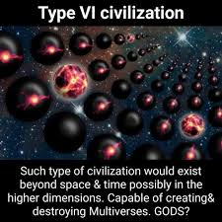

Slide 20
Type 6 Civilisation
Type 6 Civilisation (A Multidimensional Civilisation)
Requirement of massive energy to enter higher dimensions.
However, they have access to energy from white hole from various universes.
Dimensions are not places or locations.
There are level of consciousness.
Do they provide clear and wider perspective in every stage?
May be travelling backward and forward through time.
Do we experience freedom, clearer mind and closer to understand the truth?
This will be the end of civilisation advances.
Only one question remains:
Who created us and our world?

Slide 21
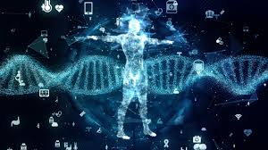

Slide 22
Type 7 Civilisation
Type 7 Civilisation (A Creator Civilisation)
It is not really a civilisation but existence itself.
Creator of all matter, energy, natural laws, space, time and dimensions.
This is God of gods.
It is hard to understand what is this level for us in level of 0.72.

Slide 23
Ethical and Legal Factors
Change of global economy
Change in environment
Change in political views.
Change in Safety, privacy and security.
Change in transportations.
Change in human interaction with each other.
Change in Law.
Change in geographical boundaries.
Change of governments.
Understanding the Nature of Life

Slide 24
Sources for this lecture
https://www.space.com/kardashev-scale
https://www.sciencefocus.com/futuretechnology/kardashevs-scale
https://www.findlight.net/blog/kardashev-scale-of-civilization-where-is-humanity/
https://www.linkedin.com/pulse/keeping-up-kardashev-scale-marcello-majonchi/?trk=pulse-article
https://www.supercluster.com/editorial/rethinking-the-kardashev-scale
https://futurism.com/kardashev-scale-this-is-what-life-will-look-like-when-we-harness-the-energy-of-the-entire-universe

